Slide 1
尼諾思科技股份有限公司 報告人：teuton
BPF CO-RE
(Compile Once - Runs Everywhere) 簡報
Notes:
Fast Packet Processing with eBPF and XDP Concepts, Code, Challenges, and Applications

Slide 2
INTRODUCTION
eBPF SYSTEM
eBPF CO-RE
eBPF PROGRAMS
Example
TOOLS
PLATFORMS

Slide 3
INTRODUCTION

Slide 4
extended Berkeley Packet Filter
technology with origins in the Linux kernel. Used as:
Network Performence
Firewall
Security
Tracing
Device Driver
Notes:
‹#›

Slide 5
eBPF SYSTEM

Slide 6
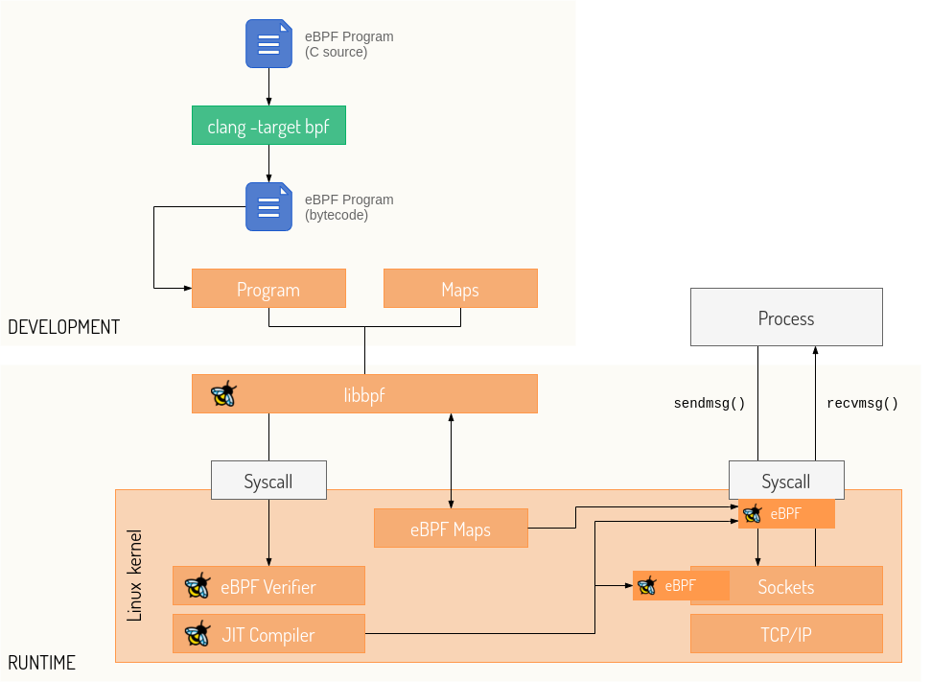
eBPF structure

Slide 7
BPF CO-RE

Slide 8
Issues with eBPF
heavy resource utilization (clang/LLVM)
dependency on kernel headers package
testing and development iteration is quite painful
Notes:
‹#›

Slide 9
BPF CO-RE component
BTF (BPF Type Format) type information
(kernel 5.5+ with CONFIG_DEBUG_INFO_BTF=y)
Compiler (clang)
BPF loader (libbpf)
advanced BPF features (kernel)
Notes:
‹#›

Slide 10
eBPF PROGRAMS

Slide 11
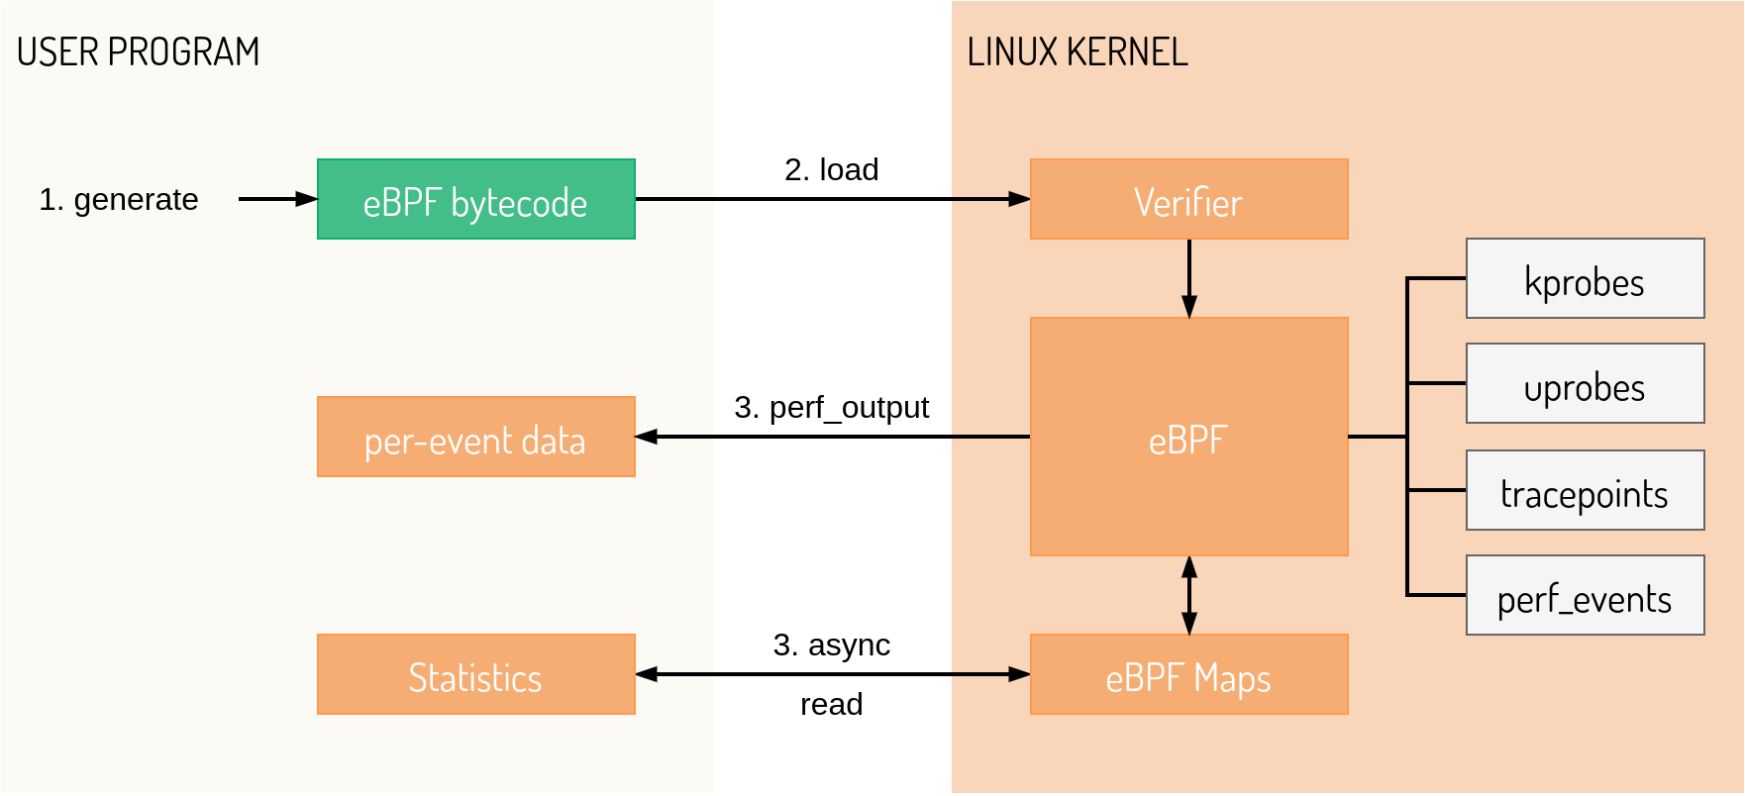
Basic program structure

Slide 12
Program types
tracepoint: Defined in source. Compiled into kernel or to be an executable. Stable between kernel versions
pre-set at /sys/kernel/debug/tracing/events/(syscalls)
probes: No source modification. Dynamically set into any target code. Must update when target code do.

Slide 13
Maps
Communication between BPF loader and BPF program
Data structure that can be shared and accessed by multiple BPF programs
hash maps
arrays
event-based structures
Handled through file descriptors in userspace programs (bpf_map__fd())

Slide 14
Helper functions
bpf_printk()
bpf_get_current_uid_gid()
bpf_get_current_pid_tgid()
bpf_get_current_comm()
libbpf_set_print(<user print>)

Slide 15
Interaction from user space with libbpf
SEC(“<attach location>”): places the function here into a special ELF section to let libbpf know where to attach the BPF program
struct {} execs SEC(“.maps”): map definition

Slide 16
Return codes
Return an integer that decides what action to take
drop a network packet
forward a network packet

Slide 17
Example
BPF CO-RE

Slide 18
How to compile BPF CO-RE?
/sys/kernel/btf/vmlinux --(bpftool)--> vmlinux.h
.bpf.c + vmlinux.h --(clang)--> .bpf.o
.bpf.o --(bpftool)--> .skel.h
.c + .skel.h --(clang)--> ELF file
Notes:
‹#›

Slide 19
BPF skeleton
Help load the BPF program and work with its maps
functions
data structures
Generated structure that describes the program that will be loaded

Slide 20
BPF app life cycle
Auto-generated in .skel.h:
Open phase <-> obj = <name>__open()
Load phase <-> <name>__load(obj)
Attachment phase <-> <name>__attach(obj)
Tear down phase <-> <name>__destroy(obj)
Notes:
‹#›

Slide 21
Example
User and kernel space interaction

Slide 22
hello.bpf.c
#include "vmlinux.h"
#include <bpf/bpf_helpers.h>
SEC("tracepoint/syscalls/sys_enter_execve")
int tracepoint__syscalls__sys_enter_execve(struct trace_event_raw_sys_enter *ctx)
Notes:
‹#›

Slide 23
hello.c part 1
struct rlimit rlim = {
.rlim_cur = 512UL << 20, /* 512 MBs */
.rlim_max = 512UL << 20,
};
err = setrlimit(RLIMIT_MEMLOCK, &rlim);
if (err)
/* handle error */
Notes:
‹#›

Slide 24
hello.c part 2
struct hello_bpf *obj;
int err = 0;
obj = hello_bpf__open();
err = hello_bpf__load(obj);
err = hello_bpf__attach(obj);
read_trace_pipe();
hello_bpf__destroy(obj);
Notes:
‹#›

Slide 25
TOOLS

Slide 26
Bpftool
Generate vmlinux.h
Rarely has to be regenerated. Unless it’s another architecture
Generate BPF skeleton with BPF binary

Slide 27
Clang
Compile bpf.c to BPF binary
Compile .o to ELF binary with BTF relocation

Slide 28
libbpf
userspace loaders
bpf_helpers.h: BPF kernel helper functions
bpf.h: defines various userspace bpf helpers for working with BPF programs and maps
libbpf.h: includes libbpf types and functions
define pre-existing observability technologies
kernel tracepoints
kprobes
user tracepoints
uprobes

Slide 29
PLATFORMS

Slide 30
Major linux distribution with BTF
Fedora 31+
RHEL 8.2+
OpenSUSE Tumbleweed (in the next release, as of 2020-06-04)
Arch Linux (from kernel 5.7.1.arch1-1)
Manjaro (from kernel 5.4 if compiled after 2021-06-18)
Ubuntu 20.10
Debian 11 (amd64/arm64)

Slide 31
Clang/LLVM 10+ packaged by default
Fedora 32+
Ubuntu 20.04+
Arch Linux
Ubuntu 20.10 (LLVM 11)
Debian 11 (LLVM 11)
Alpine 3.13+

